Slide 1

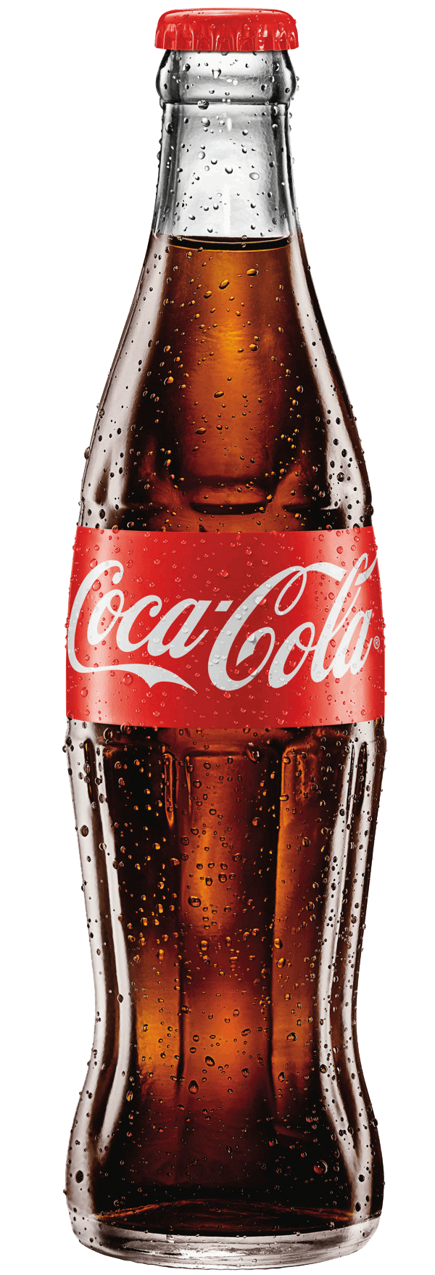
COCA COLA
COCA COLA
The Coca-Cola Company
COCA COLA
By: Vraj Patel, Arya Patel, Naman Puri, Rohan Voruganti
COCA COLA

Slide 2
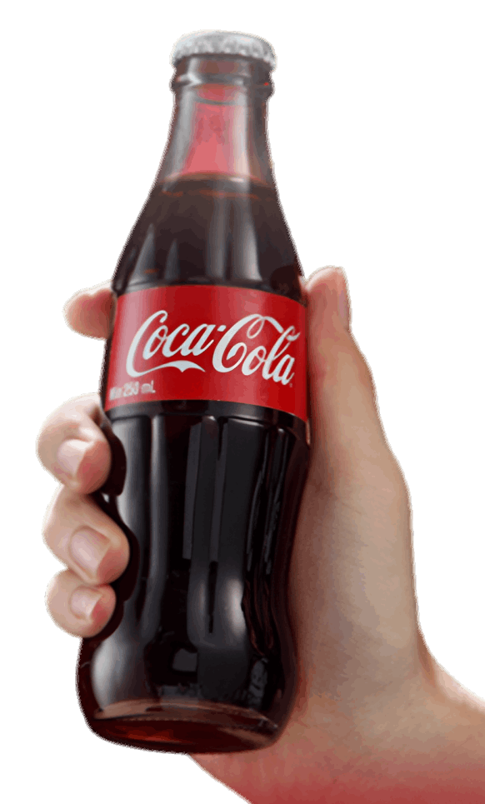
Products & Services
Total beverage company 500+ products across 195 countries
Sparkling: Coca-Cola, Sprite, Fanta
Water & Sports: Dasani, Powerade
Coffee & Tea: Costa Coffee, Gold Peak
Juice: Minute Maid
Business model: Coca-Cola provides the concentrates, while bottling partners produce, package, and distribute the beverages locally
2.2 billion servings consumed daily
Vraj

Slide 3
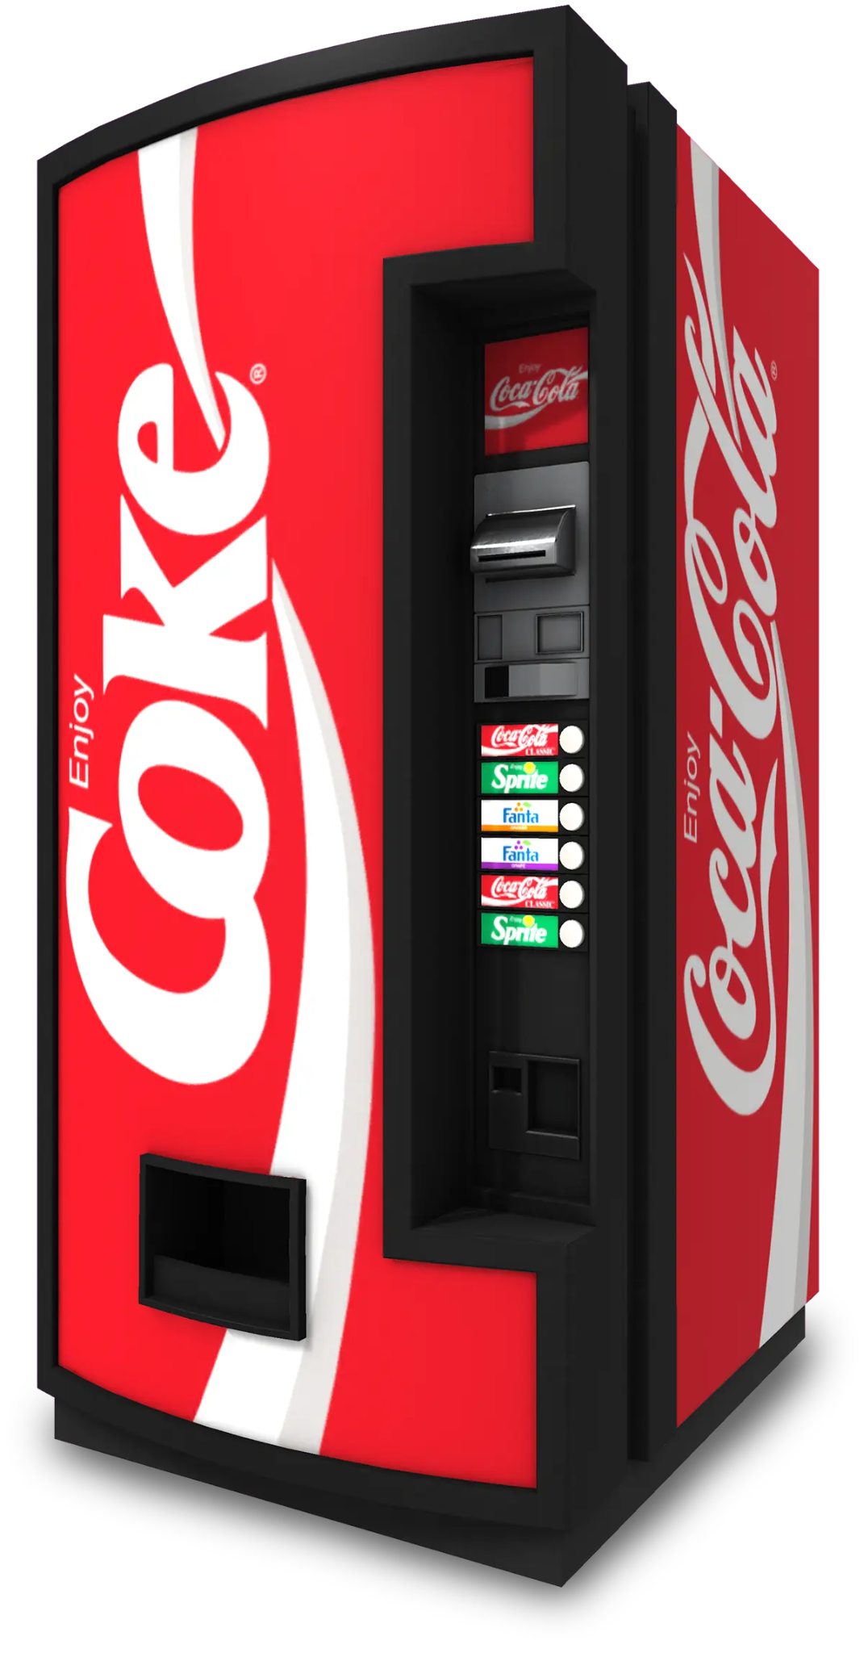
Competitive Position & Market Share
One of the world’s largest beverage companies with a strong global presence
Dominant position in sparkling soft drinks, especially through its Coca-Cola brand
50% value share of sparkling soft drinks in North America
50% value share across several international markets
33.8 billion unit cases sold through the Coca-Cola system in 2025
2.2 billion servings per day, demonstrating the scale of its global distribution
Vraj

Slide 4
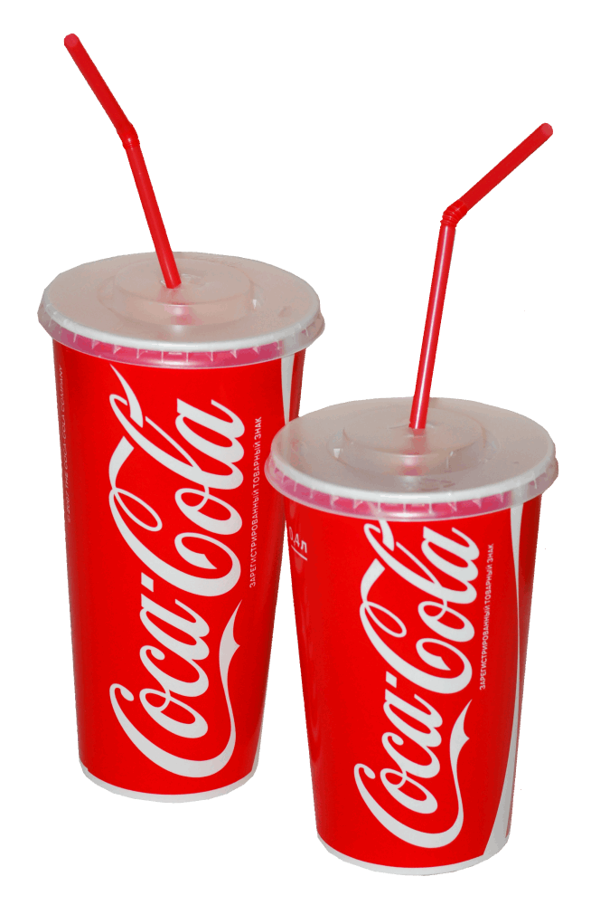
Size and Global Footprint
Revenue: $47.9B in 2025; net income of $13.1B
Valuation: ~$388B, among the largest consumer companies in the world
Reach: sold in 200+ countries and territories, ~2.2B servings a day
Portfolio: ~200 brands, 32 of them billion-dollar brands
Workforce: ~65,900 direct employees (down ~5% after refranchising bottlers)
System: 200+ independent bottling partners run production and distribution, keeping Coca-Cola asset-light
HQ: Atlanta, Georgia; founded 1892
Rohan

Slide 5
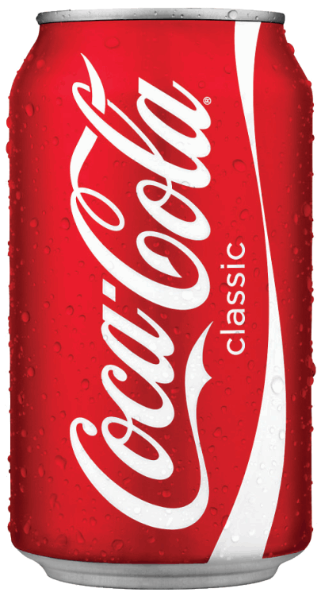
Corporate Vision, Mission, Strategies
Vision: Craft the drinks people love, refreshing them in body and spirit, while building a sustainable business and better shared future
Mission (Purpose): Refresh the world. Make a difference.
Key Strategies:
Total beverage portfolio: 200+ brands in 200+ countries
Fewer, bigger bets: Coke Zero Sugar, Fairlife, Topo Chico
Asset-light franchise model: bottling partners handle production
Digital & innovation to drive growth and brand loyalty
Sustainability built into growth (packaging, water, communities)
Rohan

Slide 6
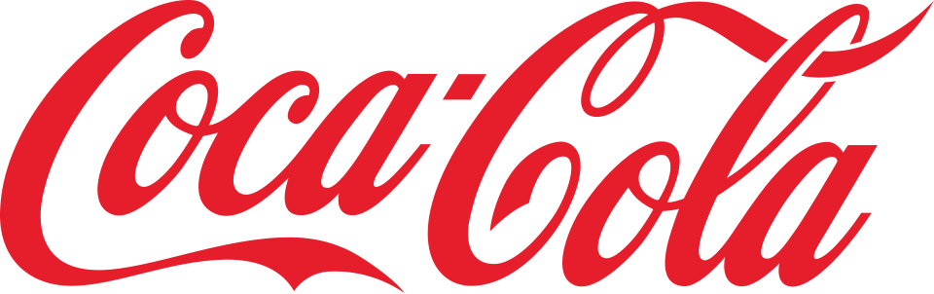
5- Year Sales And Profitability Trends
Year | Revenue($B) | Net Income($B)
2021 | $38.7 | $9.8
2022 | $43.0 | $9.6
2023 | $45.8 | $10.7
2024 | $47.1 | $10.6
2025 | $47.9 | $13.1
Key Trends:
Revenue increased from $38.7B in 2021 to $47.9B in 2025
Net income increased overall from $9.8B to $13.1B
2026 Projection: ~5% organic revenue growth
Arya

Slide 7
Key Financial Metrics- 2025
Revenue Growth
1.9%
2025 vs 2024
Return On Equity
46%
ROE
Overall: Coca-Cola remained profitable in 2025, with positive revenue growth, strong returns, and efficient inventory management.
Return On Capital
17%
ROCE
Inventory Turns
4.0x
About 4x/year
Arya

Slide 8
Supply Chain Network - Naman
Coca-Cola is a global company that operates at a local level. This means that there are currently around 225 bottling partners worldwide.
Supply sources: Coca-Cola gets its raw materials through a split system where The Coca-Cola Company makes the secret syrup, and local bottlers buy heavy ingredients like water and sugar nearby
Plants: The Coca-Cola manufacturing network operates as a massive footprint of more than 950 production facilities worldwide. Instead of owning all these factories directly, The Coca-Cola Company splits the workload with nearly 200 independent bottling partners
Warehouses: Coca-Cola relies on a decentralized network of hundreds of regional warehouses and local sales centers. This system allows them to bypass traditional retailer warehouses and deliver heavy beverages directly to local store shelves.
Retail Outlets: Coca-Cola follows an intensive distribution strategy to ensure its beverages are available in roughly 33 million retail outlets globally. Rather than selling to consumers directly, they rely on a vast commercial footprint of supermarkets, convenience stores, and gas stations to maximize reach.

Slide 9
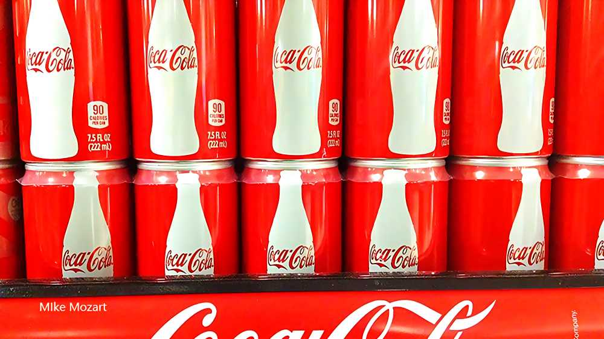
Thank You….

Slide 10
Sources:
The Coca-Cola System. (n.d.). https://www.coca-colacompany.com/about-us/coca-cola-system
Growth strategy. The Coca-Cola Company. (n.d.). https://investors.coca-colacompany.com/about/growth-strategy
Walendy, L. (2020, March 23). Amazing supply chain of Coca-Cola. All Things Supply Chain - Amazing Supply Chain of Coca-Cola. https://www.allthingssupplychain.com/amazing-supply-chain-of-coca-cola/
The Coca-Cola Company. (2026). 2025 Annual Report. https://investors.coca-colacompany.com/filings-reports/annual-filings-10-k
The Coca-Cola Company. (2024). 2023 Annual Report. https://investors.coca-colacompany.com/filings-reports/annual-filings-10-k
The Coca-Cola Company. (2026). Coca-Cola Reports Second Quarter 2026 Results and Raises Full-Year Guidance. https://investors.coca-colacompany.com/news-events/press-releases/detail/1168/coca-cola-reports-second-quarter-2026-results-and-raises-full-year-guidance
The Coca-Cola Company. (2026). Annual report (Form 10-K). U.S. Securities and Exchange Commission. https://www.sec.gov/Archives/edgar/data/21344/000162828026010047/ko-20251231.htm

